Slide 1
Chapter 4 boolean algebra and logic simplification
布尔代数和逻辑化简

Slide 2
Boolean Operations and Expressions 布尔运算和表达式
Boolean algebra is a mathematical system that defines a series of logical operations (AND, OR, NOT) performed on sets of variables (a, b, c,.….. ). When stated in this form , the expression is called a Boolean equation or switching equation.
Notes:
变量集K是布尔代数中变量的集合，它可以用任何字母表示，每个变量的取值只能是常量“0”或“1”。布尔代数又称为开关代数（逻辑代数）
不提以下概念
反码complement 是变量的反相，例如，变量A的反码是A’。A为0则A’为1
一个文字 literal 就是一个变量或者变量的反码。

Slide 3
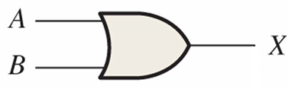
Boolean Addition 布尔加法
Addition is equivalent to the OR operation.
sum term(或项) : literals connected by +
E.g. Determine the values of A, B, and C that make the sum term of the expression A’ + B + C’ = 0?
Each literal must = 0; therefore A = 1, B = 0 and C = 1

Slide 4
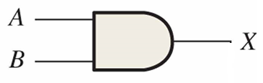
Boolean Multiplication 布尔乘法
In Boolean algebra, multiplication is equivalent to the AND operation.
product terms(与项)：literals connected by •
E.g. What are the values of the A, B and C if the product term of A.B’.C’ = 1?
Each literal must = 1; therefore A = 1, B = 0 and C = 0.

Slide 5

priority of operations
Parenthesis 圆括号
NOT 非
AND 与
OR 或
Example $ac+\overline{a}b(\overline{\overline{c}+d})$

Slide 6
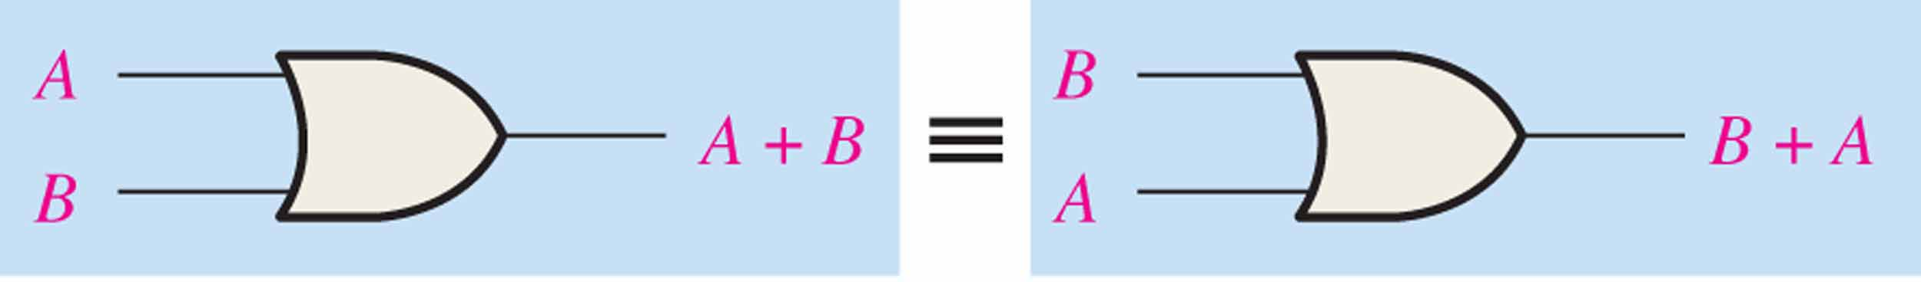
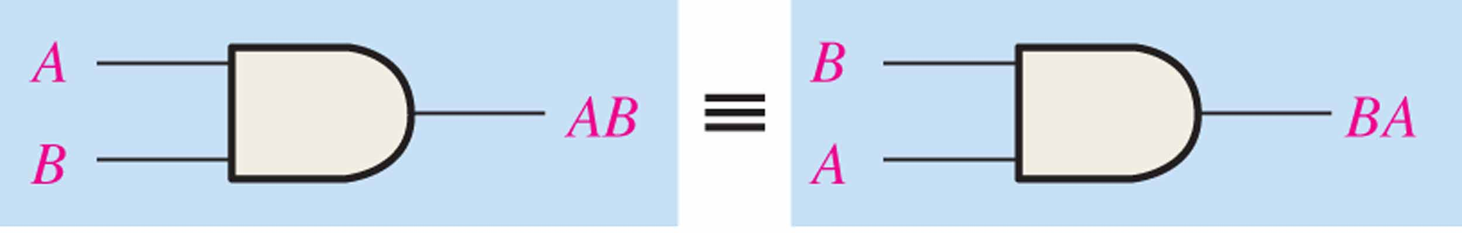
Commutative Laws 交换律
The commutative laws are applied to addition and multiplication
For addition/multiplication, the commutative law states
In terms of the result, the order in which variables are Ored/ANDed makes no difference.
A + B = B + A
AB = BA

Slide 7
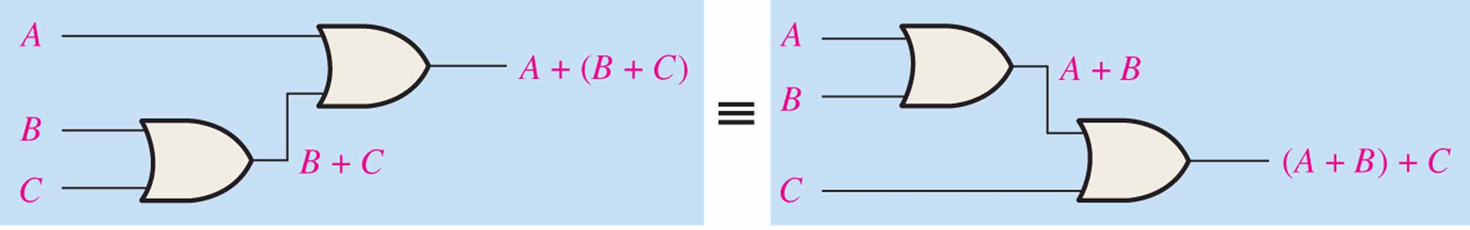
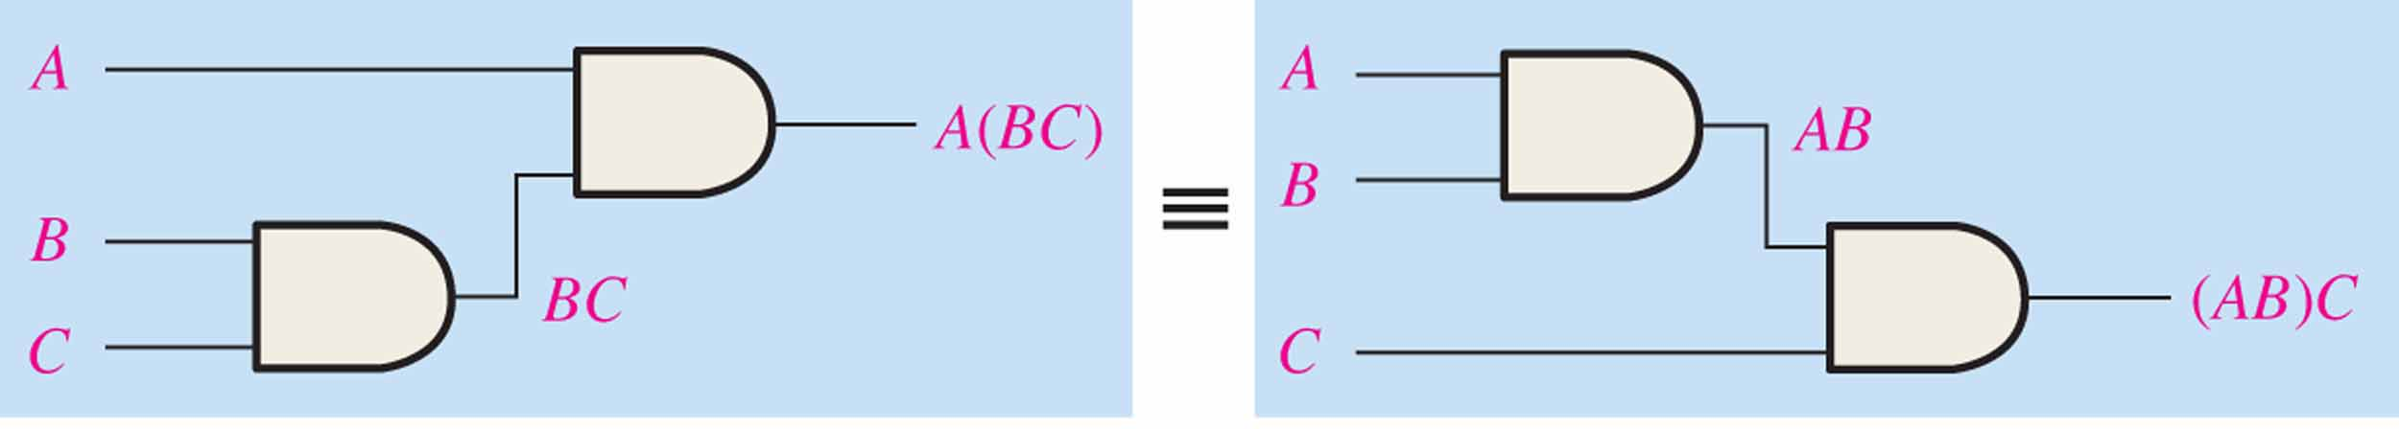
Associative Laws 结合律
The associative laws are also applied to addition and multiplication.
For addition/ multiplication, the associative law states
When Oring/ ANDing more than two variables, the result is the same regardless of the grouping of the variables.
A + (B +C) = (A + B) + C
A(BC) = (AB)C
Notes:
进一步的：可以考虑是多输入或门，或者多输入与门。

Slide 8
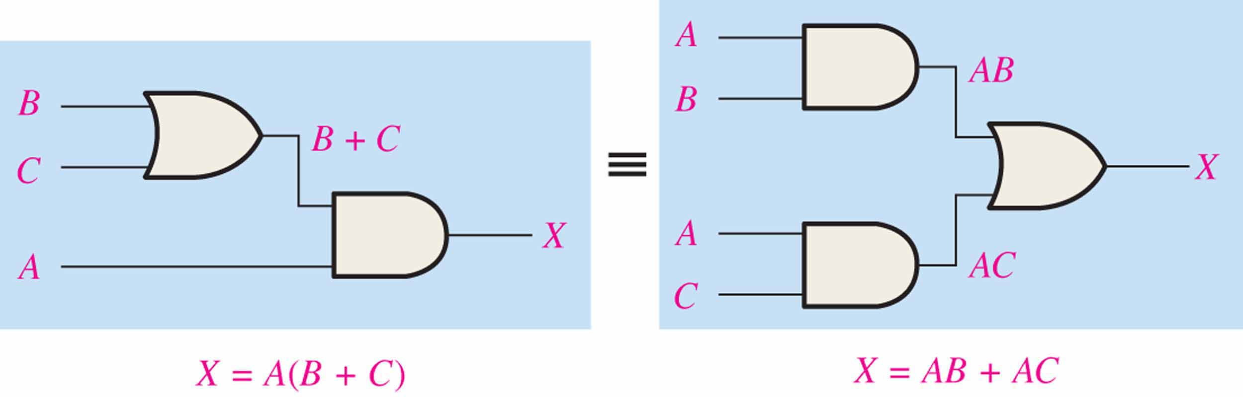
Distributive Law 分配律
The distributive law is the factoring law. A common variable can be factored from an expression just as in ordinary algebra. That is
AB + AC = A(B+ C)
Notes:
A+BC = (A+B)(A+C)

Slide 9
Rules of Boolean Algebra
Verify with truth table.
Identity Properties
0-1律
1. A + 0 = A
2. A + 1 = 1
Idempotency Property
幂等性：5. 7
5. A + A = A
7. A . A = A
Complement Properties
互补律：6.8
6. $A+\overline{A}=1$
6. 𝐴+𝐴 ̅=1
Absorption Property
吸收律：10.11
3. A . 0 = 0
4. A . 1 = A
8. $A∙\overline{A}=0$
8. 𝐴∙𝐴 ̅=0
10. A + AB = A
11. $A+\overline{A}B= A+B$
11. 𝐴+𝐴 ̅𝐵= 𝐴+𝐵
=
9. A = A
12. (A + B)(A + C) = A + BC
Distributive Properties分配律
Notes:
此处可通过真值表验证各个等式。

Slide 10
Rules of Boolean Algebra
Verify with truth table.
1. A + 0 = A
5. A + A = A
=
9. A = A
2. A + 1 = 1
6. A + A = 1
10. A + AB = A
3. A . 0 = 0
7. A . A = A
11. A + AB = A + B
4. A . 1 = A
8. A . A = 0
12. (A + B)(A + C) = A + BC
Identity Properties 0-1律 ：1. 2. 3. 4 Idempotency Property幂等性：5. 7
Absorption Property 吸收律：10.11 Distributive Properties分配律：12
Complement Properties互补律：6.8
Notes:
此处可通过真值表验证各个等式。

Slide 11
Idempotency Property
Rule 5 X+X=X and Rule 7 X·X=X

Slide 12

Absorption Property
Rule 10 X+X·Y=X and Rule 11 X+$\overline{X}$ ·Y=X+Y
These can be expand to X·(X+Y)=X and X·($\overline{X}$+Y)=X·Y

Slide 13

Adjacency Properties 邻接律
X·Y+X·$\overline{Y}$=X (X+Y) ·(X+$\overline{Y}$)=X

Slide 14
Distributive Properties (rule 12)
Rule 12, which states that (A + B)(A + C) = A + BC, can be proven by applying earlier rules as follows:
(A + B)(A + C) = AA + AC + AB + BC
= A + AC + AB + BC
= A(1 + C + B) + BC
= A . 1 + BC
= A + BC

Slide 15
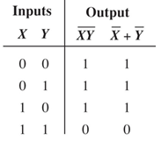
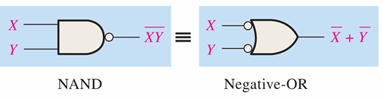

DeMorgan’s Theorem 德*摩根定律
DeMorgan’s 1st Theorem
The complement of a product of variables is equal to the sum of the complemented variables.
$$\overline{XY}=\overline{X}+\overline{Y}$$

Slide 16
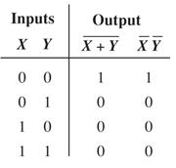
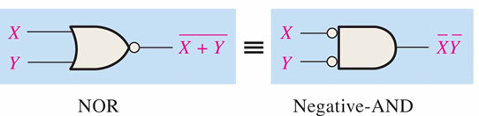

DeMorgan’s Theorem 德*摩根定律
DeMorgan’s 2st Theorem
The complement of a sum of variables is equal to the product of the complemented variables.
$$\overline{X+Y}=\overline{X}∙\overline{Y}$$

Slide 17

DeMorgan’s Theorem
$$\overline{XY}=\overline{X}+\overline{Y}$$
$$\overline{X+Y}=\overline{X}∙\overline{Y}$$
DeMorgan’s Theorem can be proven by applying Complement Properties
Rule 6 A+A’=1 and Rule 8 A·A’=0

Slide 18
DeMorgan’s Theorem

Slide 19


DeMorgan’s Theorem
Example
Apply DeMorgan’s theorem to remove the overbar covering both terms from the expression $X=\overline{\overline{C}+D}$
Solution
To apply DeMorgan’s theorem to the expression, you can break the overbar covering both terms and change the sign between the terms. This results in
$X=\overline{\overline{C}}∙\overline{D}$. Deleting the double bar gives $X=C∙\overline{D}$.

Slide 20
DeMorgan’s Theorem
Example
Use DeMogan’s Theorem to find an equivalent to F=x (y+ z’)’
Solution
1. Applying DeMorgan’s theorm
F = x(y’∙z’’)=xy’z
2. Applying DeMorgan’s theorm on F=[x (y+ z’)’ ]’’
F=[x’+ (y+ z’)’’)]’=(x’+y+z’)’

Slide 21
Boolean Analysis of Logic Circuits 逻辑电路分析
Combinational logic circuits can be analyzed by writing the expression for each gate and combining the expressions according to the rules for Boolean algebra.
Example
Apply Boolean algebra to derive the expression for X.
Solution
Write the expression for each gate:
Applying DeMorgan’s theorem and the distribution law:
(A + B )
C (A + B )
= C (A + B )+ D
X = C (A B) + D = A B C + D
X

Slide 22
Notes:
Equivalent form

Slide 23
Functionally Complete Operation Sets 功能完全操作集
功能完全操作集（ Functionally Complete Operation Sets）是一组逻辑函数集，它能实现所有的组合逻辑表达式。
FC₁={AND、OR、NOT}
FC₂={NOR}
xy=(x’+y’)’，x+y=(x+y)’’，x’=(x+0)’
FC₃={NAND}
xy=(xy)’’，x+y=(x’y’)’，x’=(xx)’
FC₄={XOR、AND}
x’=1⊕x，x+y=x⊕y⊕xy

Slide 24
Simplification using Boolean algebra 布尔代数化简
Some common rules：
AB+AB’=A (并项法)
e.g. A’BC+A’BC’=A’B
A+AB=A (吸收法)
e.g. C’+AB’C’=C’
A+A’B=A+B (消去法)
e.g. A’+AB+DE=A’+B+DE
Use A·1=A and A+A’=1 to expand some items before simplified. (配项法)
e.g. A’B+AC’+BC’ =A’B+AC’+(A’+A)BC’ =A’B(1+C’)+AC’(1+B) =A’B+AC’

Slide 25
Simplification using Boolean algebra
Using Boolean algebra techniques, simplify this expression:
F(A,B,C)=(A’(B+C’))’(A+B’+C)(A’B’C’)’
F(A,B,C)=(A’(B+C’))’(A+B’+C)(A’B’C’)’
=(A+(B+C’)’)(A+B’+C)(A+B+C)
=(A+B’C)(A+C+B’B)
=(A+B’C)(A+C)
=(A+B’)(A+C)(A+C)
=(A+B’)(A+C)
=A+B’C

Slide 26
Exercise
Using Boolean algebra techniques, simplify this expression:
1. F=A’C’(B’+BD)+A’CD
2. F=(A⊕B)(AB+A’B’)’+AB
3. F=(A+B+C)(A’+B’+C’)
Answer：
1. A’B’C’+A’D
2. A+B (consider the XOR gate and the XNOR gate)
3. A’C+AB’+BC’（AC’+B’C+A’B）
Notes:
第三题可以两种解法，不熟悉的可以用分配法后，把每一项都拆开，用配项法，去除重复项后再继续化简。熟悉的也可以直接用之前所给配项法结论，直接找形如A’B+AC’+BC’=A’B+AC’的形式消除

Slide 27

SOP and POS forms “积之和” 与 “和之积”
Boolean expressions can be written in the sum-of-products form (SOP) or in the product-of-sums form (POS). These forms can simplify the implementation of combinational logic.
In both forms, an overbar cannot extend over more than one variable.
$\overline{A}\overline{B}\overline{C}$√ $\overline{ABC }$×

Slide 28
Definitions
product terms(与项)：literals connected by •
AB A’BC
sum terms(或项)： literals connected by +
A+B A+B’+C
Notes:
与项，布尔变量之间用“·”连接
或项，布尔变量之间用“+”连接

Slide 29

SOP and POS forms
An expression is in SOP form when two or more product terms are summed as in the following examples:（积之和：与项做或操作）
$\overline{A}\overline{B}\overline{C}+AB$ $AB+\overline{C}D$ $CD+E$
An expression is in POS form when two or more sum terms are multiplied as in the following examples:（和之积：或项做与操作）
$(A+B)(A+\overline{C})$ $(A+B+\overline{C})(B+D)$ $\left(\overline{A}+B\right)C$

Slide 30
Domain of Boolean Expression
The domain of a general Boolean expression is the set of variables contained in the expression in either complemented or uncomplemented form.
E.g. The domain of F(A,B,C)=AB+C is A,B,C
E.g. The domain of F(A,B,C,D,E)=AB+CD+D’E is A,B,C,D,E
Notes:
Domain在涉及最小项/最大项的表达式里很关键。

Slide 31
Definitions
product terms(与项)：literals connected by •
sum terms(或项)： literals connected by +
Minterm(最小项): a product term in which all the variables in the domain appear exactly once, either complemented or uncomplemented
Maxterm(最大项): a sum term in which all the variables in the domain appear exactly once, either complemented or uncomplemented
Notes:
与项，布尔变量之间用“·”连接
或项，布尔变量之间用“+”连接
最小项*，特殊“与项”，域中的每个变量都以原变量或反变量的形式在其中出现，且仅出现一次。
最大项*：特殊“或项”，域中的每个变量都以原变量或反变量的形式在其中出现，且仅出现一次

Slide 32
Minterm
A | B | F
0 | 0 | A’B’
0 | 1 | A’B
1 | 0 | AB’
1 | 1 | AB
Represents exactly one combination in the truth table.
Denoted by m_{j}, where j is the decimal equivalent of the minterm’s corresponding binary combination (0 replace the complement and 1 replace the uncomplement).
E.g. A domain of (A, B) has 2² minterms. A’B’=m₀, A’B=m₁, AB’=m₂, AB=m₃
E.g. M(a,b,m,s)=a’bms+ab’ms+abms=m₇+m₁₁+m₁₅=∑m(7,11,15)
Notes:
一个逻辑函数如果有两个变量（A, B），则总共有2²个最小项，分别是A’B’, A’B, AB’, AB。
最小项用符号m_{i}表示。下标i的确定方式为：把项中的原变量用1代替，反变量用0代替，得到的二进制数的等值十进制数值。
最小项性质：
任意一个最小项，只有一组变量取值使该最小项的值为1。
任意两个最小项间的“与”运算结果为0。
n个变量的2^{n}个最小项的“或”运算逻辑结果为1

Slide 33
MAXTERM
Represents exactly one combination in the truth table.
Denoted by M_{j}, where j is the decimal equivalent of the maxterm’s corresponding binary combination (0 replace the uncomplement and 1 replace the complement).
F(a,b,c)=(a’+b+c’)(a+b+c’)(a+b’+c’)=M₁M₃M₅=∏M(1,3,5)
101 001 011
M₅ M₁ M₃
Notes:
最大项性质：
任意一个最大项，只有一组变量取值使该最大项的值为0。
任意两个最大项间的“或”运算结果为1。
n个变量的2^{n}个最大项的“与”运算逻辑结果为0。

Slide 34
Minterms and Maxterms
m_{i}’=M_{i}, M_{i}’=m_{i}
E.g. Let F(A,B)=A’B’+AB=m₀+m₃
F’(A,B) = (A’B’+AB)’
= (A’B’)’(AB)’
= (A+B)(A’+B’)
= AB’+A’B=m₂+m₁
F(A,B) = F’’(A,B)=(AB’+A’B)’
=(A’+B)(A+B’)=M₁M₂
Notes:
1. m_{i}与M_{i}的关系可以使用德摩根定律推导。
2. 留意PPT中所给函数间的互补关系。
最小项和最大项，下标相同时，是一种互为反函数的关系。

Slide 35
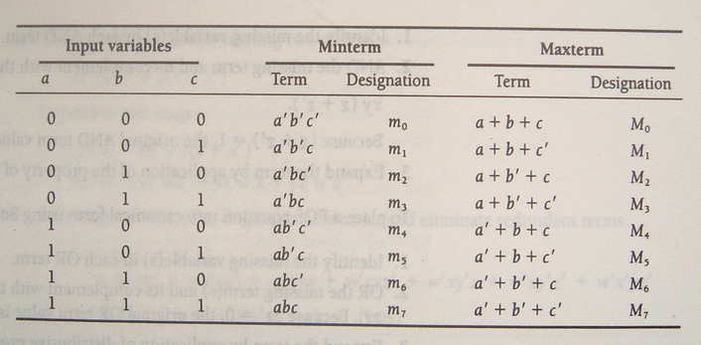
Truth Table notation for Minterms and Maxterms
3 variables a,b,c (order is fixed)

Slide 36
SOP Standard form 标准积之和形式
Each term is a minterm.
In SOP standard form, every variable in the domain must appear in each term. This form is useful for constructing truth tables or for implementing logic in PLDs.
Converting Product Terms to Standard SOP(use rule 6 A+A’=1)
Example
Convert X = A B + A B C to standard form.
Solution
The first term does not include the variable C. Therefore, multiply it by the (C + C), which = 1:
X = A B (C + C) + A B C
= A B C + A B C + A B C
Notes:
后续会学到一些元器件，给定域之后可以直接产生最小项，对计算函数结果比较便利。

Slide 37

SOP Standard form
A Standard product term(minterm) is equal to 1 for only one combination of variable values, and is 0 for all other combinations of values for the variables.
E.g. $A\overline{B}C\overline{D}=1∙\overline{0}∙1∙\overline{0}=1∙1∙1∙1=1$
A SOP expression is equal to 1 only if one or more of the product terms in the expression is equal to 1.
E.g. M(a,b,m,s)=a’bms+ab’ms+abms=m₇+m₁₁+m₁₅=∑m(7,11,15)

Slide 38
POS Standard form 标准和之积形式
Each term is a maxterm.
In POS standard form, every variable in the domain must appear in each sum term of the expression.
Converting Sum Terms to Standard POS(use rule 8 A∙A’=0)
Example
Convert X = (A + B)(A + B + C) to standard form.
Solution
The first sum term does not include the variable C. Therefore, add C C and expand the result by rule 12.
X = (A + B + C C)(A + B + C)
= (A +B + C )(A + B + C)(A + B + C)

Slide 39

POS Standard form
A Standard sum term(maxterm) is equal to 0 for only one combination of variable values, and is 1 for all other combinations of values for the variables
E.g. $A+\overline{B}+C+\overline{D}=0+\overline{1}+0+\overline{1}=0+0+0+0=0$
A POS expression is equal to 0 only if one or more of the sum terms in the expression is equal to 0.
E.g. F(a,b,c)=(a’+b+c’)(a+b+c’)(a+b’+c’)=M₁M₃M₅=∏M(1,3,5)

Slide 40
Converting standard sop to standard pos
Recall the previous example, and pay attention to the subscript.
F(A,B)=A’B’+AB=m₀+m₃ F’(A,B) = AB’+A’B=m₂+m₁
F(A,B) =(A’+B)(A+B’)=M₁M₂
Convert Example 4-19(P119) to ∑m() and ∏M() forms.
A’B’C’+A’BC’+A’BC+AB’C+ABC= ∑m(0,2,3,5,7)
(A+B+C’)(A’+B+C)(A’+B’+C)= ∏M(1, 4, 6)
WHY?

Slide 41
Boolean Expressions and Truth Tables 布尔表达式和真值表
SOP Standard form:
The minterms included are those m_{j} such that F( ) = 1 in row j of the truth table for F( ).
每个最小项与真值表中输出函数为1的行相对应。
POS Standard form:
The maxterms included are those M_{j} such that F( ) = 0 in row j of the truth table for F( ).
每个最大项与真值表中输出函数为0的行相对应。

Slide 42
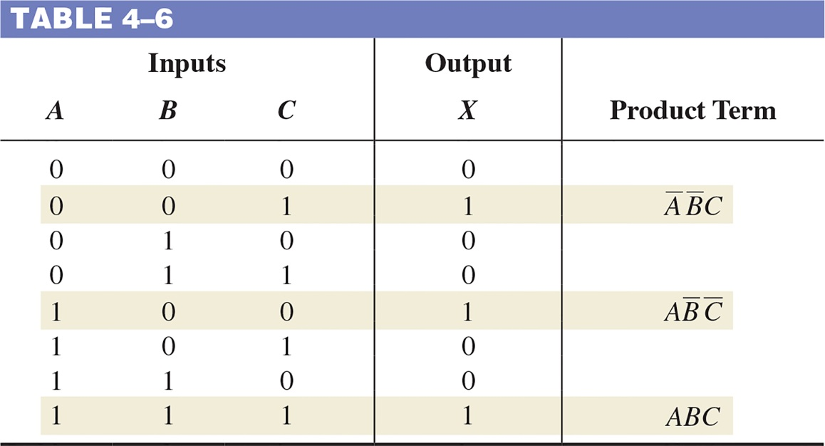
Converting SOP Expressions to Truth Table Format
F = A’B’C + AB’C’ + ABC
= ∑(1,4,7)

Slide 43
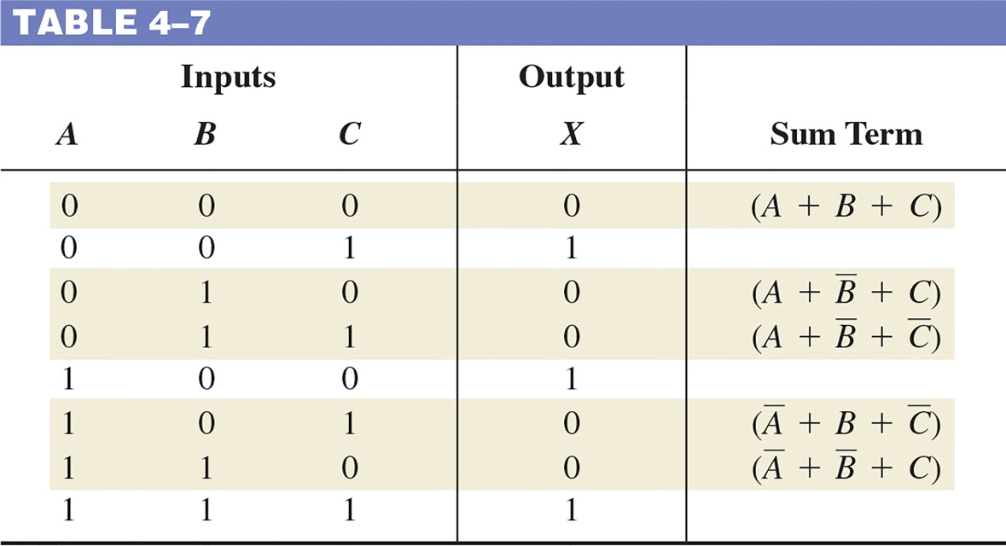
Converting POS Expressions to Truth Table Format
F = (A+B+C)(A+B’+C)
( A+B’+C’)(A’+B+C’)
(A’+B’+C)
= ∏(0,2,3,5,6)

Slide 44
Determining Standard Expressions from a Truth Table
Truth table for f(a,b,c)
a | b | c |  | f
0 | 0 | 0 |  | 0
0 | 0 | 1 |  | 1
0 | 1 | 0 |  | 1
0 | 1 | 1 |  | 0
1 | 0 | 0 |  | 1
1 | 0 | 1 |  | 0
1 | 1 | 0 |  | 1
1 | 1 | 1 |  | 0
SOP Standard form：
f(a,b,c) = m₁+m₂+m₄+m₆ = a’b’c+a’bc’+ab’c’+abc’ = ∑m(1,2,4,6)
POS Standard form：
f(a,b,c) = M₀ · M₃ · M₅ · M₇ = (a+b+c)(a+b’+c’)(a’+b+c’)(a’+b’+c’) = ∏M(0,3,5,7)
Observe that：
M_{i}=m_{i}’
f(a,b,c) = ∑m(1,2,4,6) = ∏M(0,3,5,7)

Slide 45
Shorthand: ∑ and ∏
f(a,b,c) = ∑ m(1,2,4,6), where ∑ indicates that this is a sum-of-products form, and m(1,2,4,6) indicates that the minterms to be included are m₁, m₂, m₄, and m₆.
f(a,b,c) = ∏ M(0,3,5,7), where ∏ indicates that this is a product-of-sums form, and M(0,3,5,7) indicates that the maxterms to be included are M₀, M₃, M₅, and M₇.
∑m(1,2,4,6) = ∏ M(0,3,5,7) = f(a,b,c)

Slide 46
Exercise
1. Write out the equivalent SOP and POS standard forms of the truth table for f at right.
2. Convert the following to stand forms.
F(w,x,y,z)=w’x+yz’
G(a,b,c,d)=(a+b’+c)(a’+d)
3. Convert the following to stand POS forms
F(A,B,C)=A’B’C’+A’BC’+A’BC
a | b | c |  | f
0 | 0 | 0 |  | 1
0 | 0 | 1 |  | 0
0 | 1 | 0 |  | 0
0 | 1 | 1 |  | 0
1 | 0 | 0 |  | 1
1 | 0 | 1 |  | 1
1 | 1 | 0 |  | 1
1 | 1 | 1 |  | 0

Slide 47
Exercise
a | b | c |  | f
0 | 0 | 0 |  | 1
0 | 0 | 1 |  | 0
0 | 1 | 0 |  | 0
0 | 1 | 1 |  | 0
1 | 0 | 0 |  | 1
1 | 0 | 1 |  | 1
1 | 1 | 0 |  | 1
1 | 1 | 1 |  | 0
1. Write out the equivalent SOP and POS standard forms of the truth table for f at right.
f = m₀ + m₄ + m₅ + m₆ = a’b’c’ + ab’c’ + ab’c + abc’
f = M₁ · M₂ · M₃ · M₇ = (a+b+c’)(a+b’+c)(a+b’+c’)(a’+b’+c’)

Slide 48
2. Convert the following to stand forms
F(w,x,y,z)=w’x+yz’
G(a,b,c,d)=(a+b’+c)(a’+d)
Solution：
F(w,x,y,z) = w’x(y+y’)(z+z’)+(w+w’)(x+x’)yz’ = wxyz’+wx’yz’+w’xyz+w’xyz’ + w’xy’z+w’xy’z’+w’x’yz’
G(a,b,c,d) = (a+b’+c+dd’)(a’+bb’+cc’+d) = (a+b’+c+d) (a+b’+c+d’) (a’+b+c+d) (a’+b’+c+d) (a’+b+c’+d) (a’+b’+c’+d)

Slide 49
Exercise
3. Convert the following to stand POS forms
F(A,B,C) = A’B’C’+A’BC’+A’BC
F(A,B,C) = A’B’C’+A’BC’+A’BC = ∑m(0, 2, 3) = ∏M(1, 4, 5, 6, 7) = (A+B+C’)(A’+B+C)(A’+B+C’)(A’+B’+C)(A’+B’+C’)

Slide 50
HOMEWORK
1. Simplifying Boolean Functions
F(x,y,z)=∑(0,2,3,4,5,7)
F(a,b,c,d)=∑(0,3,4,5,7,11,13,15)
F(w,x,y,z)=∑(0,1,4,5,9,11,13,15) F(a,b,c,d)=∑(0,1,2,4,5,6,8,9,12,13,14)
F(a,b,c,d)=∑(1,3,4,5,7,8,9,11,15)
F(w,x,y,z)=∑(1,5,7,8,9,10,11,13,15)

Slide 51
HOMEWORK
2. Page 141
10 a/d/e
15 b/d
16 b
21 b/c
24 c

Slide 52
The Karnaugh map 卡诺图
The Karnaugh map (K-map) is a tool for simplifying combinational logic.
The Karnaugh map is an array of cells in which each cell represents a binary value of the input variables.
For n variables, 2^{n} cells are required.
for 3 variables need 8 cells.
Notes:
卡诺图的作用：化简逻辑函数
卡诺图是一个方格矩阵。n个变量的卡诺图有2^{n}个小方格。
一个单元格对应着真值表中的一行。
一个单元格对应着逻辑表达式中的一个最大项或者一个最小项。

Slide 53
The Karnaugh map
Cells are usually labeled using 0’s and 1’s to represent the variable and its complement
Ones are read as the true variable and zeros are read as the complemented variable.
Each cell differs from an adjacent cell by only one variable.
A’BC’
A’BC
ABC

Slide 54
Karnaugh maps: 2 variables
A | B | F
0 | 0 | 1
0 | 1 | 1
1 | 0 | 1
1 | 1 | 0
A B | 0 | 1
0 | 1 | 1
1 | 1 | 0
A B | 0 | 1
0 | A’B’ | AB’
1 | A’B | AB
A B | 0 | 1
0 | m₀ | m₂
1 | m₁ | m₃
Notes:
以2变量卡诺图为例，熟悉如何从真值表填写卡诺图，进一步熟悉，卡诺图每个小方格所对应的含义。
在变量固定顺序为（A，B）的情况下，可以使用最小项方式填写。

Slide 55
Karnaugh maps
Logic adjacency : Any two adjacent cells in the map differ by ONLY one.
A
AB
AB
B
0
1
C
00
01
11
10
CD
00
01
11
10
0
m₀
m₂
0
m₀
m₂
m₆
m₄
00
m₀
m₄
m₁₂
m₈
1
m₁
m₃
1
m₁
m₃
m₇
m₅
01
m₁
m₅
m₁₃
m₉
11
m₃
m₇
m₁₅
m₁₁
E.g. m₀ (=x₁’x₂’) is adjacent to m₁ (=x₁’x₂) and m₂ (=x₁x₂’) but NOT m₃ (=x₁x₂)
10
m₂
m₆
m₁₄
m₁₀
Notes:
体会逻辑相邻在边界处的特殊。

Slide 56
CELL Adjaency
Notes:
体会逻辑相邻在边界处的特殊。

Slide 57
Mapping sop expression to k-map
Standard Sop expression.
Each 1 is placed in a cell corresponding to the value of a standard product term.
Nonstandard SOP expression
1. Convert it to standard Sop form before fill the K-map.
2. Fill the K-map directly with each product term(get rid of the redundant 1).

Slide 58
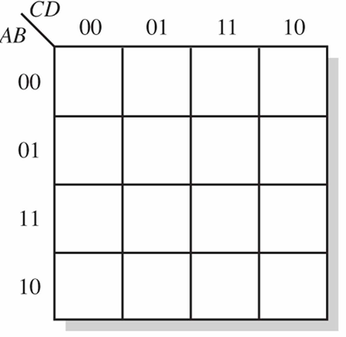

Mapping sop expression to k-map
EXAMPLE 4-24 . Map the following standard SOP expression on a Karnaugh map:
$\overline{A}\overline{B}CD+\overline{A}B\overline{C}\overline{D}+AB\overline{C}D+ABCD+AB\overline{C}\overline{D}+\overline{A}\overline{B}\overline{C}D+A\overline{B}C\overline{D}$
1
1
1
1
1
1
1

Slide 59
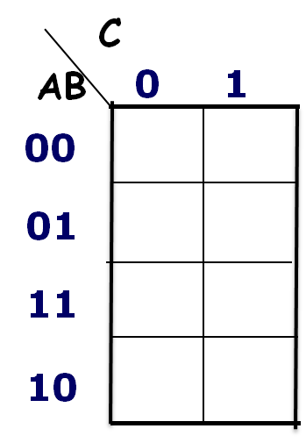
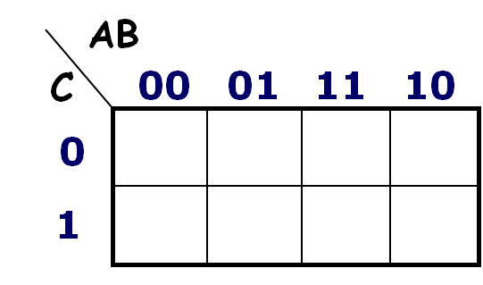
Mapping sop expression to k-map
E.g. F(A,B,C)=A’BC+A’BC’+AB
Solution:
1. Convert to standard SOP form.
F = A’BC+A’BC’+AB = A’BC+A’BC’+ABC+ABC’
1
1
1
1
1
1
1
1

Slide 60
Mapping sop expression to k-map
E.g. Map the following SOP expression on a Karnaugh map:
F(A,B,C,D)=A’B+D’C’+AB’CD’
AB
CD
00
01
11
10
00
1
1
1
1
01
1
11
1
10
1
1

Slide 61
Karnaugh Map Simplification SOP Expressions
x₂
0
1
x₁
f(x₁,x₂) = x₁’x₂’+ x₁’x₂ + x₁x₂’ = m₀ + m₁ + m₂
What (simpler) function is represented by each dashed rectangle?
x₁’x₂’+ x₁’x₂ =x₁’(x₂’+x₂)=x₁’
x₁’x₂’+ x₁x₂’=x₂’(x₁’+x₁) =x₂’
f(x₁,x₂) =x₁’+x₂’
0
0
2
1
1
1
1
3
1
0

Slide 62
Karnaugh Map Simplification SOP Expressions
Enter 1s in the K-map for each product term in the function
Group adjacent K-map cells containing 1s to obtain a product with fewer variables.
Groups must be in power of 2 (1, 2, 4, 8, …)
Handle “boundary wrap” for K-maps of 3 or more variables.

Slide 63
Karnaugh Map Simplification SOP Expressions
K-maps can simplify combinational logic by grouping cells and eliminating variables that change.
Example
Group the 1’s on the map and read the minimum logic.
Solution
1. Group the 1’s into two overlapping groups as indicated.
Read each group by eliminating any variable that changes across a boundary.
B changes across this boundary
The vertical group is read AC.
X = AC +AB
C changes across this boundary
The horizontal group is read AB.

Slide 64
Karnaugh Map Simplification SOP Expressions
Example
Group the 1’s on the map and read the minimum logic.
C changes across outer boundary
Solution
1. Group the 1’s into two separate groups as indicated.
Read each group by eliminating any variable that changes across a boundary.
B changes
B changes
The upper (yellow) group is read as AD.
The lower (green) group is read as AD.
C changes
X
X = AD +AD

Slide 65
Four-variable Map Simplification
One square represents a minterm of 4 literals.
A rectangle of 2 adjacent squares represents a product term of 3 literals.
A rectangle of 4 squares represents a product term of 2 literals.
A rectangle of 8 squares represents a product term of 1 literal.
A rectangle of 16 squares produces a function that is equal to logic 1

Slide 66
Karnaugh Map Simplification SOP Expressions
Simplify the following Boolean function F(A,B,C,D) with Karnaugh maps.
F(A,B,C,D) = ∑m(0,1,2,3,4,5,6,7,8,10,13).
AB
00
01
11
10
CD
00
1
1
1
01
1
1
1
11
1
1
F(A,B,C,D)= A’+B’D’+BC’D
10
1
1
1

Slide 67
Karnaugh Map Simplification SOP Expressions
Always include the largest possible number of 1s in a group. The group must be in power of 2 (1, 2, 4, 8, …)
Each 1 on the map must be included in at least one group.
Each group must have a unique 1.

Slide 68
Example
Choose 1、2.
And then you can choose 3 or 4 for m₂.
F(A,B,C,D)=∑m(0,2,4,10,11,14,15)
AB
CD
1
00
1
1
0
0
01
0
0
0
0
F(A,B,C,D)=A’C’D’+AC+A’B’D’ 或F(A,B,C,D)=A’C’D’+AC+B’CD’
11
0
0
1
1
2
10
1
0
1
1
4
3

Slide 69
Exercise
Simplifing Boolean Functions with K-map 1. F(w,x,y,z)=∑(0,1,4,5,9,11,13,15) 2. F(a,b,c,d)=∑(0,1,2,4,5,6,8,9,12,13,14)

Slide 70
Exercise
F(w,x,y,z)=∑(0,1,4,5,9,11,13,15)
Solution：F(w,x,y,z)=w’y’+wz
wx
yz
00
01
11
10
00
1
1
0
0
01
1
1
1
1
11
0
0
1
1
10
0
0
0
0

Slide 71
Exercise
F(a,b,c,d)=∑(0,1,2,4,5,6,8,9,12,13,14)
Solution：F(a,b,c,d)=c’+a’d’+bd’
ab
cd
00
01
11
10
00
1
1
1
1
01
1
1
1
1
11
0
0
0
0
10
1
1
1
0

Slide 72
Don‘t Care Conditions 随意项，无关条件
There may be a combination of input values which
will never occur
if they do occur, the output is of no concern.
The function value for such combinations is called a don't care.
They are denoted with d, x or –. Each d may be arbitrarily assigned the value 0 or 1 in an implementation.
Don’t cares can be used to further simplify a function
Notes:
输入变量的有些组合可能会
从不出现
即便出现了，输出结果也无人关注。
例如：1110₂，1111₂ 不会出现在8421BCD码中
这些组合所对应的最小项或者最大项被称之为随意项。随意项在卡诺图中的值可以随意的被置成0或者1。

Slide 73
Don‘t Care Conditions
When grouping the 1s, the don’t care condition can be treated as 1s to make a larger grouping or as 0s if then cannot be used to advantage.
Don’t take any group that only contain don’t care conditions.

Slide 74
Example
cd
ab
00
01
11
10
00
0
1
0
1
01
1
1
0
1
11
0
0
d
d
Simplify the function f(a,b,c,d) whose K-map is shown at the right.
f = a’c’d+ab’+cd’+a’bc’
or
f = a’c’d+ab’+cd’+a’bd’
10
1
1
d
d
0
1
0
1
1
1
0
1
0
0
d
d
1
1
d
d
0
1
0
1
1
1
0
1
0
0
d
d
1
1
d
d

Slide 75
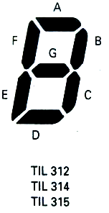

Example seven-segment display
E.g. Design a combinational circuit that will accept a 2421BCD code and drive a TIL-312 seven-segment display
Decimal | w | x | y | z
0 | 0 | 0 | 0 | 0
1 | 0 | 0 | 0 | 1
2 | 1 | 0 | 0 | 0
3 | 1 | 0 | 0 | 1
4 | 1 | 0 | 1 | 0
5 | 1 | 0 | 1 | 1
6 | 1 | 1 | 0 | 0
7 | 1 | 1 | 0 | 1
8 | 1 | 1 | 1 | 0
9 | 1 | 1 | 1 | 1

Slide 76
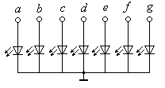
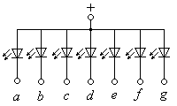
seven-segment display*
共阳极
要求显示译码器具有输出反相门、集电极开路输出结构，并且要求译码器能够吸收显示器的输出电流。
共阴极
要求显示译码器无输出反相门，输出为集电极电阻输出或射极开路输出结构，并且要求译码器有电流流向显示器。

Slide 77
2421BCD | Min-Max | inputs |  |  |  | outputs
Decimal | Term Decimal | w | x | y | z | A | B | C | D | E | F | G
0 | 0 | 0 | 0 | 0 | 0 | 0 | 0 | 0 | 0 | 0 | 0 | 1
1 | 1 | 0 | 0 | 0 | 1 | 1 | 0 | 0 | 1 | 1 | 1 | 1
2 | 8 | 1 | 0 | 0 | 0 | 0 | 0 | 1 | 0 | 0 | 1 | 0
3 | 9 | 1 | 0 | 0 | 1 | 0 | 0 | 0 | 0 | 1 | 1 | 0
4 | 10 | 1 | 0 | 1 | 0 | 1 | 0 | 0 | 1 | 1 | 0 | 0
5 | 11 | 1 | 0 | 1 | 1 | 0 | 1 | 0 | 0 | 1 | 0 | 0
6 | 12 | 1 | 1 | 0 | 0 | 0 | 1 | 0 | 0 | 0 | 0 | 0
7 | 13 | 1 | 1 | 0 | 1 | 0 | 0 | 0 | 1 | 1 | 1 | 1
8 | 14 | 1 | 1 | 1 | 0 | 0 | 0 | 0 | 0 | 0 | 0 | 0
9 | 15 | 1 | 1 | 1 | 1 | 0 | 0 | 0 | 0 | 1 | 0 | 0

Slide 78
Example seven-segment display
A=∑(1,10)
B=∑(11,12)
C=∑(8)
D=∑(1,10,13)
E=∑(1,9,10,11,13,15)
F=∑(1,8,9,13)
G=∑(0,1,13)
A=w’z+x’yz’
B=xy’z’+x’yz
C=wx’y’z’
D=xy’z+x’yz’+w’z
E=x’y+z
F=wx’y’+y’z
G=w’+xy’z
A=[(w’z)’(x’yz’)]’
B=[(xy’z’)’(x’yz)’]
C=(wx’y’z’)’’
D=[(xy’z)’(x’yz’)’(w’z)’]’
E=[(x’y)’(z)’]’
F=[(wx’y’)’(y’z)’]’
G=[(w)(xy’z)’]’
Consider ∑ (2,3,4,5,6,7)
Notes:
2，3，4，5，6，7是不会出现的最小项，可用于化简。最后，上述标准积之和形式，可以全部使用“与非”门实现。

Slide 79
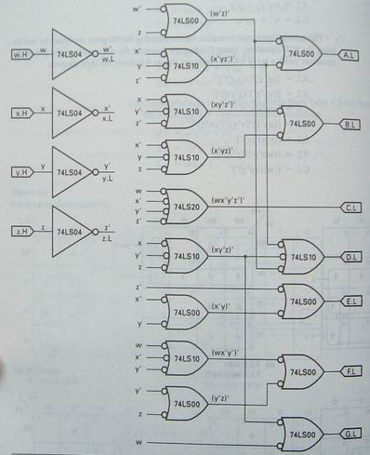

Slide 80
Homework
3. Simplifying Boolean Functions
1). V = f(a,b,c,d) = ∑m(2,3,4,5,13,15) + ∑d(8,9,10,11)
2). Y = f(u,v,w,x) = ∑m(1,5,7,9,13,15) + ∑d(8,10,11,14)

